Slide 1
Neuroscience
Signal Processing
Quantitative Methods Workshop 2022
Taylor Baum

Slide 2

Taylor Baum
tbaum@mit.edu
taylor.e.baum@gmail.com
https://www.linkedin.com/in/taylor-baum-b1a4aa105/

Slide 3
Today, we will be learning about brain signals, and how you can extract information from these signals to make decisions.

Slide 4
General Neuroscience

Slide 5

Neuroscience is the study of the nervous system. More often than not, it is
primarily associated with the study of the brain.
Notes:
Photo: https://www.salon.com/2021/10/24/the-brain-has-a-backup-system-why-people-missing-much-of-their-brain-can-miraculously-recover/

Slide 6
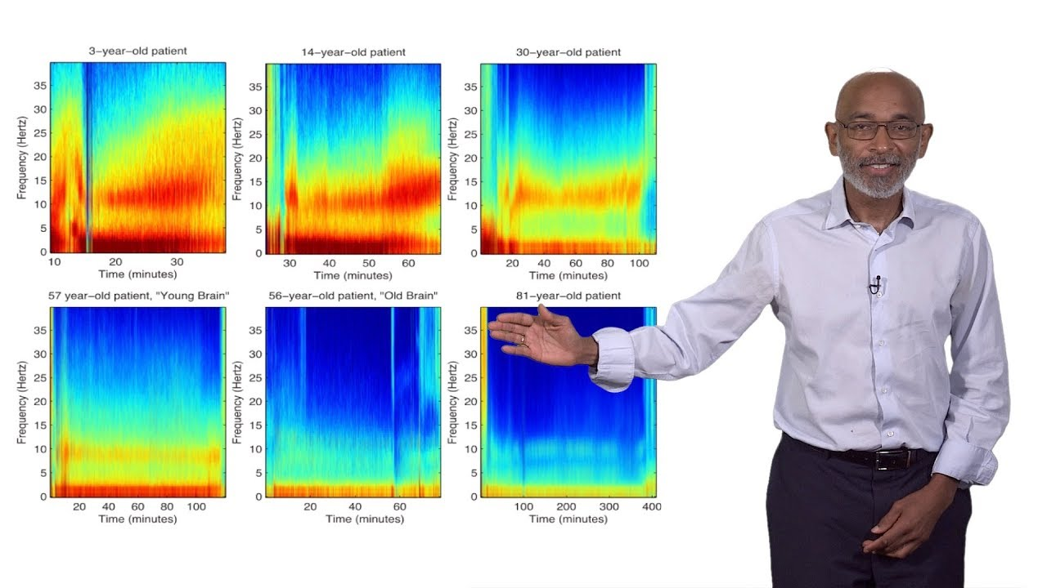
My experience in neuroscience focuses on the system level.
Notes:
Photo: https://www.ibiology.org/neuroscience/anesthesia-brain/

Slide 7
In systems neuroscience, we look at the activity of some neurons and try to understand how that activity is related to phenomenon that we wish to study.
Notes:
Photo: https://www.ibiology.org/neuroscience/anesthesia-brain/

Slide 8
Question: What is a neuron?

Slide 9
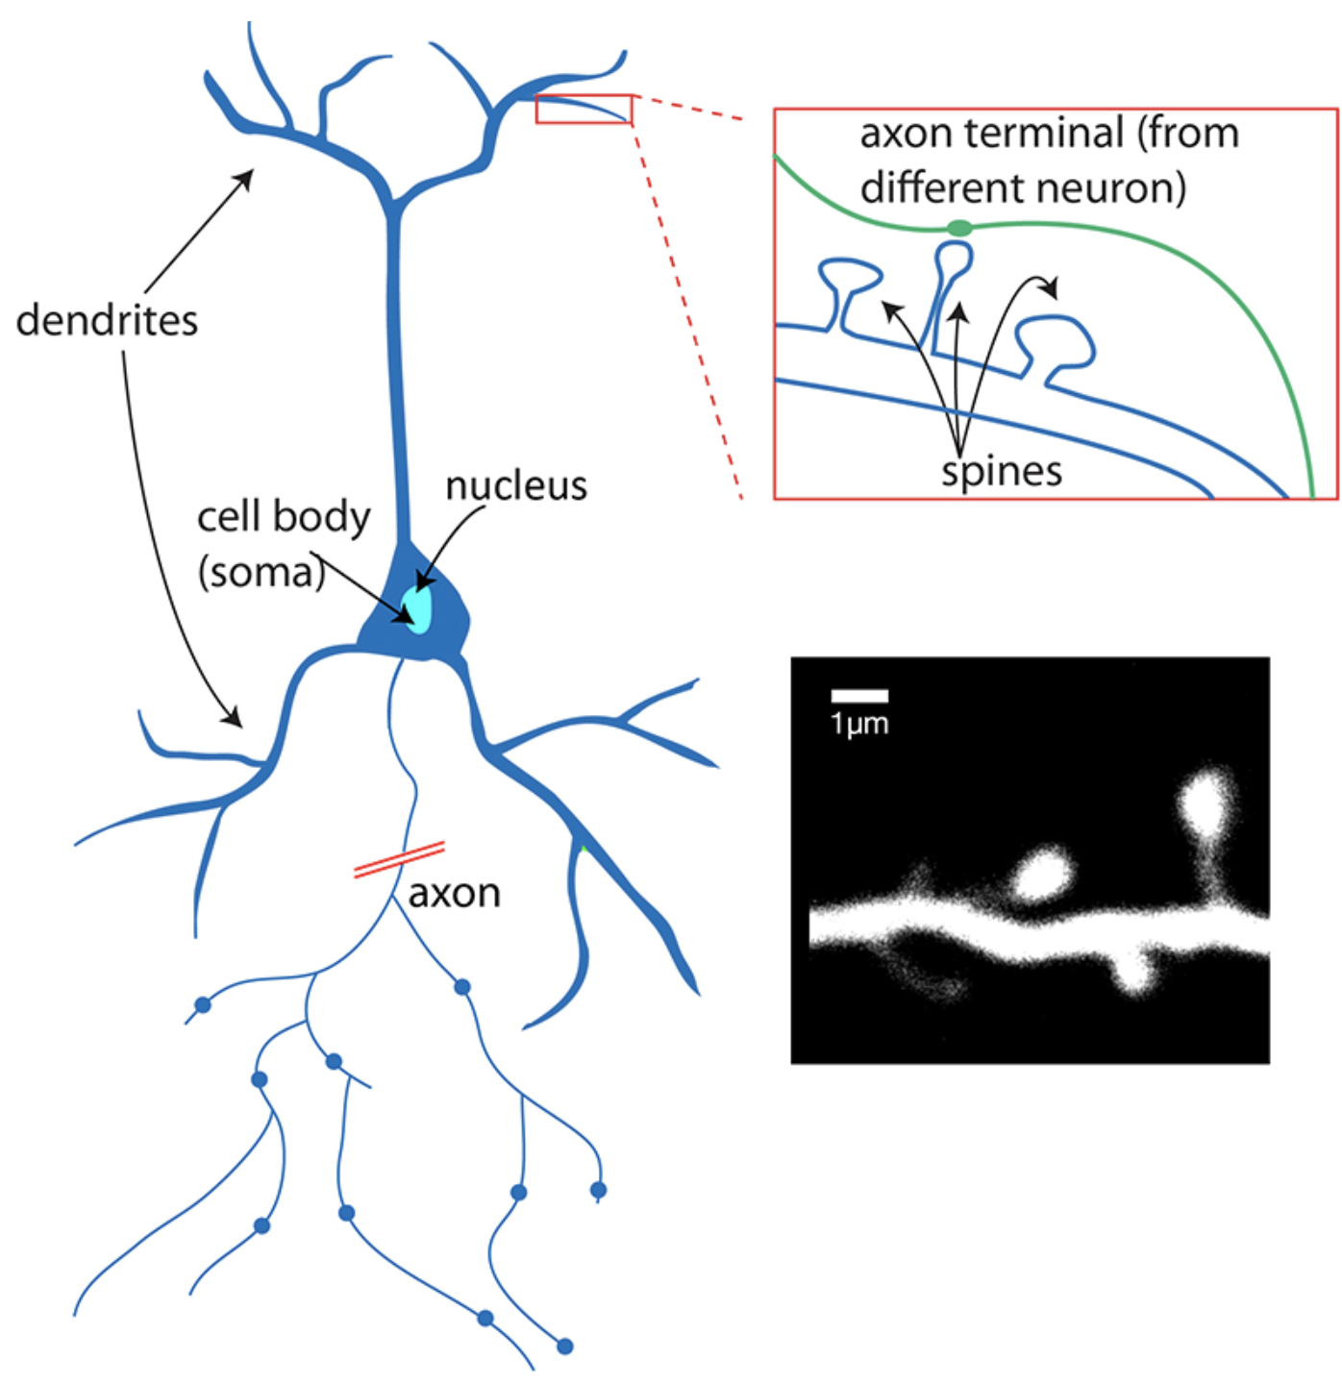
Neurons are the fundamental units of the nervous system; they transmit electrical signals throughout the brain and nervous system.
This is what makes neuroscience extremely relevant to electrical engineers like myself.
Notes:
https://qbi.uq.edu.au/brain/brain-anatomy/what-neuron

Slide 10
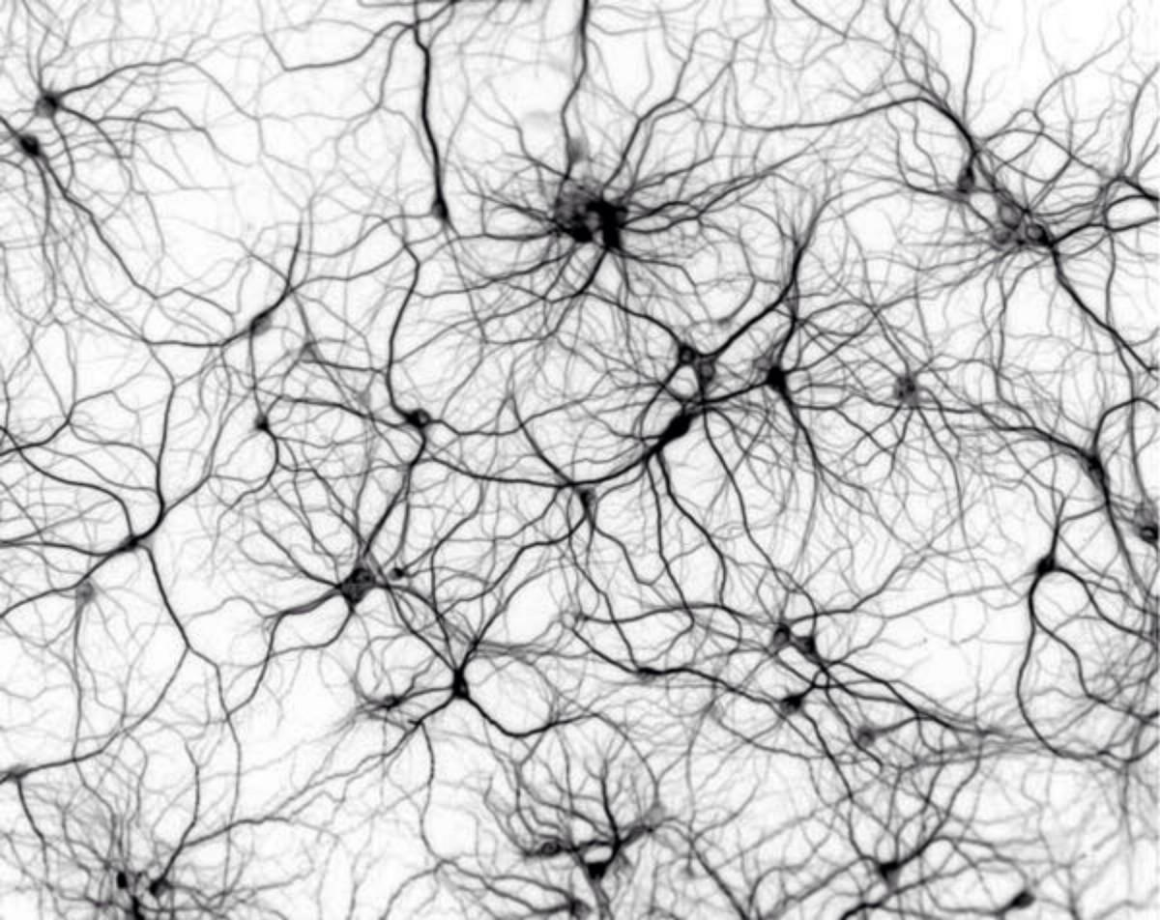
In the brain, we have neurons that are oriented in all different directions, and they transfer information between one another through electrical signals.

Slide 11
Today, we will be exploring brain signals collected through electroencephalography (EEG).

Slide 12
Electroencephalography (EEG)

Slide 13
What does an EEG detect?

Slide 14
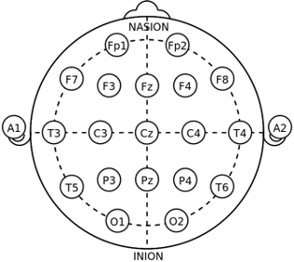
Electroencephalography detects electrical activity in the brain.
Notes:
Photo: https://www.istockphoto.com/photos/eeg-test

Slide 15
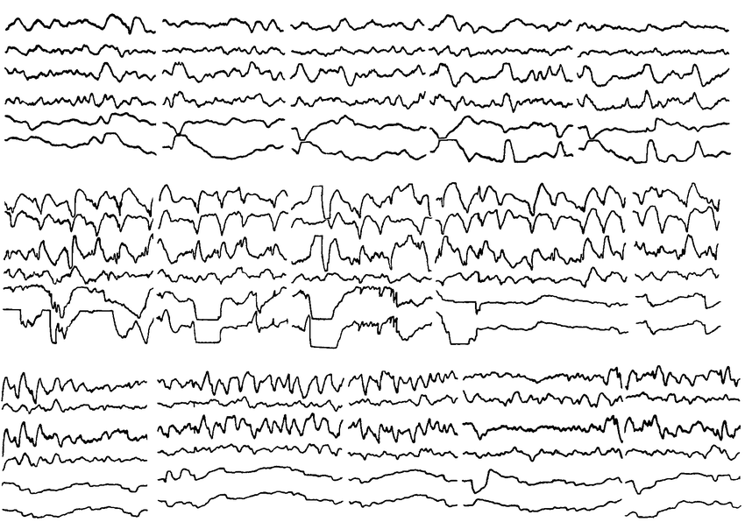
Let’s try and understand what exactly an electroencephalogram is detecting!
Notes:
Photo: https://www.researchgate.net/figure/EEG-and-EOG-responses-to-visual-stimuli-a-red-spot-and-a-black-and-white-contrasting_fig1_226078506

Slide 16
The signals coming out of an EEG are electrical potentials measured in Volts!
Notes:
Photo: https://www.researchgate.net/figure/EEG-and-EOG-responses-to-visual-stimuli-a-red-spot-and-a-black-and-white-contrasting_fig1_226078506

Slide 17
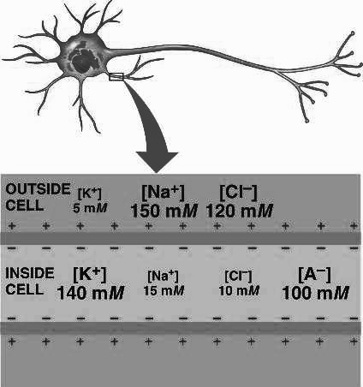
The electrical potentials contained in neurons are generated by differences in concentrations of charge across cell membranes known as ion gradients.
Notes:
Photo: https://www.https://bio1152.nicerweb.com/Locked/media/ch48/gradients.html.com/watch?v=Jk_9IhHVOTk

Slide 18
We are going to start thinking about this “differences in concentrations of charge” in the context of a really famous equation, Ohm’s law.
V = IR
Voltage = Current * Resistance

Slide 19
This equation describes the relationship between voltage and current, both which result from the ion gradients.
V = IR
Voltage = Current * Resistance

Slide 20
Voltage (V in Volts) is the difference in electrical potential between any two
points in an electrical circuit.
V = IR
Notes:
https://battlebornbatteries.com/amps-volts-watts/

Slide 21
Current (I in amps) is the speed or rate at which the electrons flow through a resistor.
V = IR
Notes:
https://battlebornbatteries.com/amps-volts-watts/

Slide 22

To reemphasize the definition of voltage and current, we consider a
water analogy.
Notes:
https://battlebornbatteries.com/amps-volts-watts/

Slide 23
For water to move through a hose (current to flow), there needs to be a difference in pressure (voltage) between two locations in the pipe.
High Pressure
Low
Pressure
Notes:
https://battlebornbatteries.com/amps-volts-watts/

Slide 24
If there is no difference in pressure (voltage), then there is no flow (current) through the pipe.
Low
Pressure
Low
Pressure
Notes:
https://battlebornbatteries.com/amps-volts-watts/

Slide 25
The existence of the pipe is the resistance to flow.
Low
Pressure
Low
Pressure
Notes:
https://battlebornbatteries.com/amps-volts-watts/

Slide 26
Resistance (R in Ohms) is the resistance to flow of electrons.
V = IR
Notes:
https://battlebornbatteries.com/amps-volts-watts/

Slide 27
So, we can account for all three components of ohm’s law here.
V = IR
Notes:
https://battlebornbatteries.com/amps-volts-watts/

Slide 28
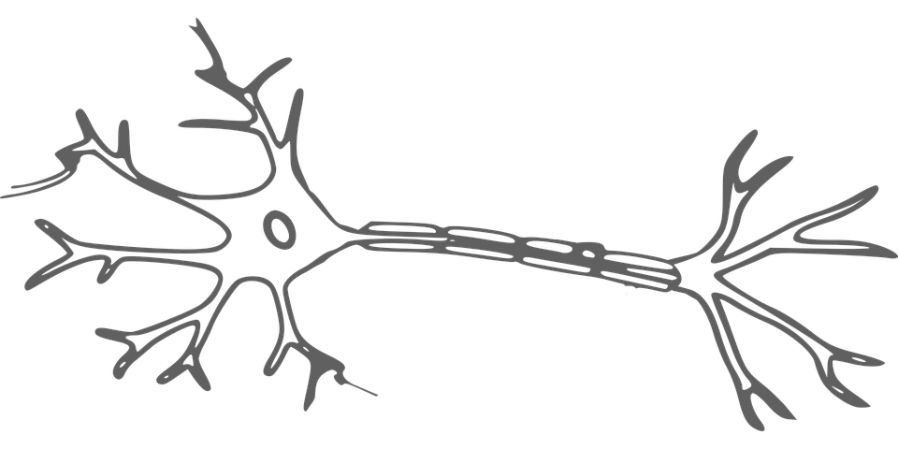
This concept is equivalent for electrical signals in neurons.

Slide 29
There needs to be some difference in charge concentration between two points in the neuron for electrical charge to flow (current).
Large Positive Charge
High Pressure
Low
Pressure
Small Positive Charge
or Negative Charge

Slide 30
Think of this flow of charge as a transfer of information. With no flow, there is no information being transferred.
Large Positive Charge
High Pressure
Low
Pressure
Small Positive Charge
or Negative Charge

Slide 31
Question: What happens when there is a difference in pressure between two points in a pipe?

Slide 32
Water will flow through a pipe.
High Pressure
Low
Pressure
This is our water analogy of voltage.

Slide 33
Question: What happens when there is voltage across a resistor?

Slide 34
Electrons or electrical charge will flow through the resistor.
V = IR
This is what Ohm’s law states.

Slide 35
Question: What happens when there is a difference in charge across a neuronal membrane?

Slide 36
Electrical charges or ions will flow through a neuron.
Large Positive Charge
Small Positive Charge
or Negative Charge
This is sort of what the EEG will pick up!

Slide 37
Any questions about:
electrical signals
voltage
current
neuronal communication

Slide 38
Let’s dig deeper into what the EEG detects!

Slide 39
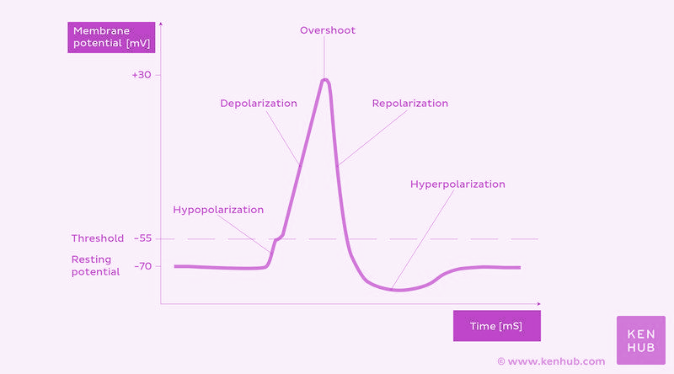
An action potential is when the membrane voltage of a neuron gets positive
enough that a wave of positive ions moves through the neuron.

Slide 40
In order for flow or an action potential to happen, a big enough membrane
potential, voltage, or difference in charge is needed.

Slide 41
EEGs don’t detect the action potential, but instead detect charge build-up in the extracellular space resulting, in the excitatory case, from the hypopolarization of the intracellular space.

Slide 42
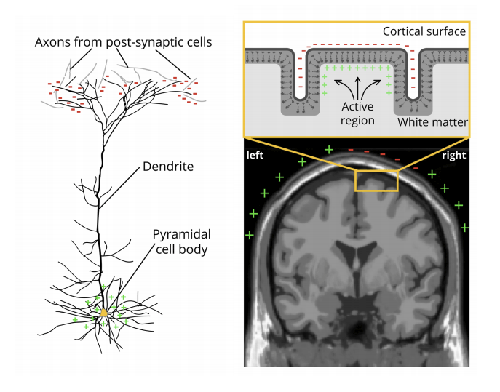
More generally, EEGs detect the build up of charge leading either to a neuron firing (Excitatory Postsynaptic Potential EPSP) or a neuron becoming less likely to fire (Inhibitory Postsynaptic Potential IPSP).

Slide 43
Let’s consider the Excitatory Postsynaptic Potential (EPSP) in a cell that is
oriented on the cortex according to the figure below.

Slide 44
For EPSPs, the post-synaptic potential of a neuron must cross a threshold
of -55 mV before the neuron will fire.

Slide 45
Before a neuron reaches that -55 mV threshold, there are positive ions rushing
into the neuron increasing the membrane potential and creating a negative
charge outside of the cell.

Slide 46
In a portion of a neuron that is away from the negative extracellular region, those positive ions are flowing out of the cell, creating a positive charge externally.

Slide 47
This difference in charge should remind us of what we mentioned earlier.
Large Positive Charge
High Pressure
Low
Pressure
Small Positive Charge
or Negative Charge

Slide 48
While this difference in charge eventually leads to an action potential, it is the existence of the difference in charge that the EEG picks up.

Slide 49
The single electrical dipole created in one neuron isn’t strong enough for an
EEG to detect it.

Slide 50
But, there are special neurons near the surface of the brain called pyramidal
neurons that are all oriented in the same direction.
Notes:
https://www.mayoclinic.org/tests-procedures/eeg/about/pac-20393875

Slide 51
So instead of single neuron recordings, we look at the summed activity of many pyramidal neurons.

Slide 52
So instead of single neuron recordings, we look at the summed activity of many pyramidal neurons.
Notes:
https://www.mayoclinic.org/tests-procedures/eeg/about/pac-20393875

Slide 53
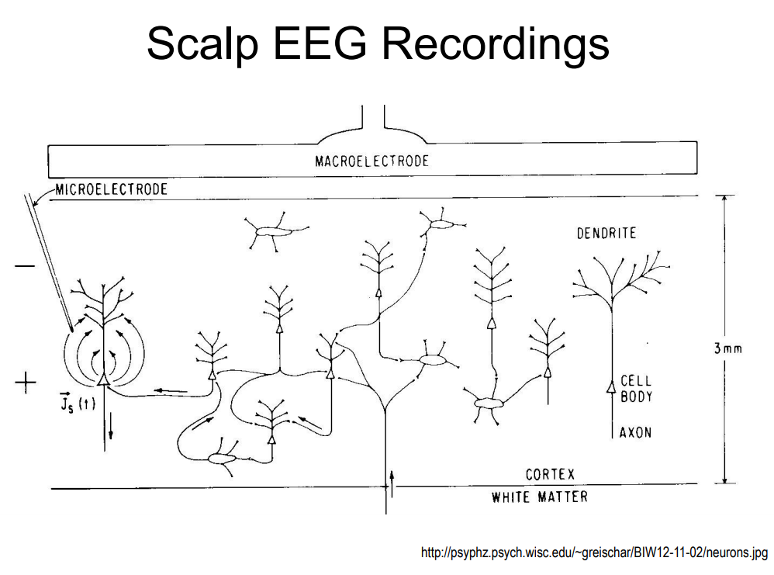
So instead of single neuron recordings, we look at the summed activity of many pyramidal neurons.
Notes:
Photo: https://www.mayoclinic.org/tests-procedures/eeg/about/pac-20393875

Slide 54
It is also important to keep in mind that EEG signals result from synchronous activity within the pyramidal neurons.
Notes:
Photo: https://www.mayoclinic.org/tests-procedures/eeg/about/pac-20393875

Slide 55
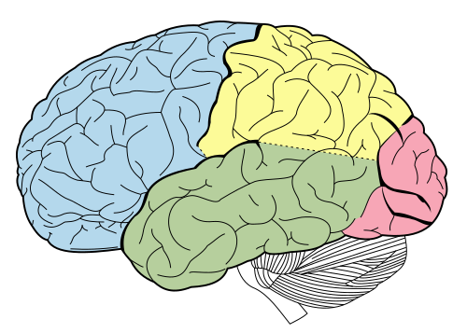
For today’s workshop, we will be looking at EEG signals specifically coming from
the occipital lobe.
Occipital Lobe
Notes:
Photo: https://www.wikiwand.com/en/Occipital_lobe

Slide 56
Question: Does anyone know what happens in the back of the brain?

Slide 57
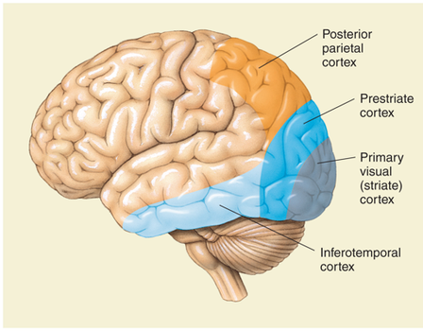
The primary visual cortex (V1) is located in the back of the brain.
This is where visual processing occurs in the brain!

Slide 58
Now we have an idea about where the EEG signal comes from, physiologically.

Slide 59
Build an Experiment:
Given what you learned about the brain, and EEG signals, propose an example experiment you could run to learn more about the brain using EEG.
Notes:
You can navigate to this website to give you some ideas or guidance for design: http://www.mit.edu/~6.s085/notes/lecture7.pdf

Slide 60
Steady State Visually
Evoked Potentials (SSVEPs)

Slide 61

You should have reviewed the paper that was sent out, and watched the video that was recommended!

Slide 62
Question: What is an SSVEP signal?

Slide 63
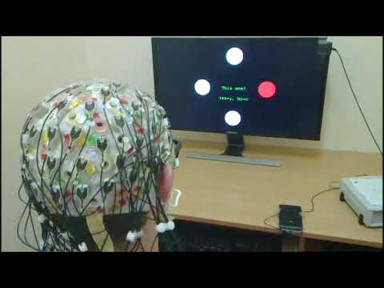
When you stimulate the eye with something which is blinking at a certain frequency, the brain generates electrical activity at that frequency.
SSVEP signals are generated at the back of the brain.

Slide 64
Given all of this information about brain signals, let’s move into some of the techniques we will be using to analyze these signals.

Slide 65
Signal Processing

Slide 66
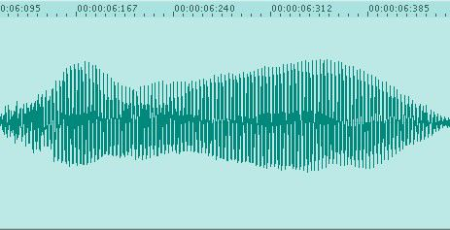
Signal Processing is a field where you take a signal and try to get information from that signal.
Notes:
Photo: https://www.cs.hmc.edu/~kperdue/MusicalDSP.html

Slide 67
Some obvious applications of signal processing are with music signals!
Notes:
Photo: https://www.cs.hmc.edu/~kperdue/MusicalDSP.html

Slide 68
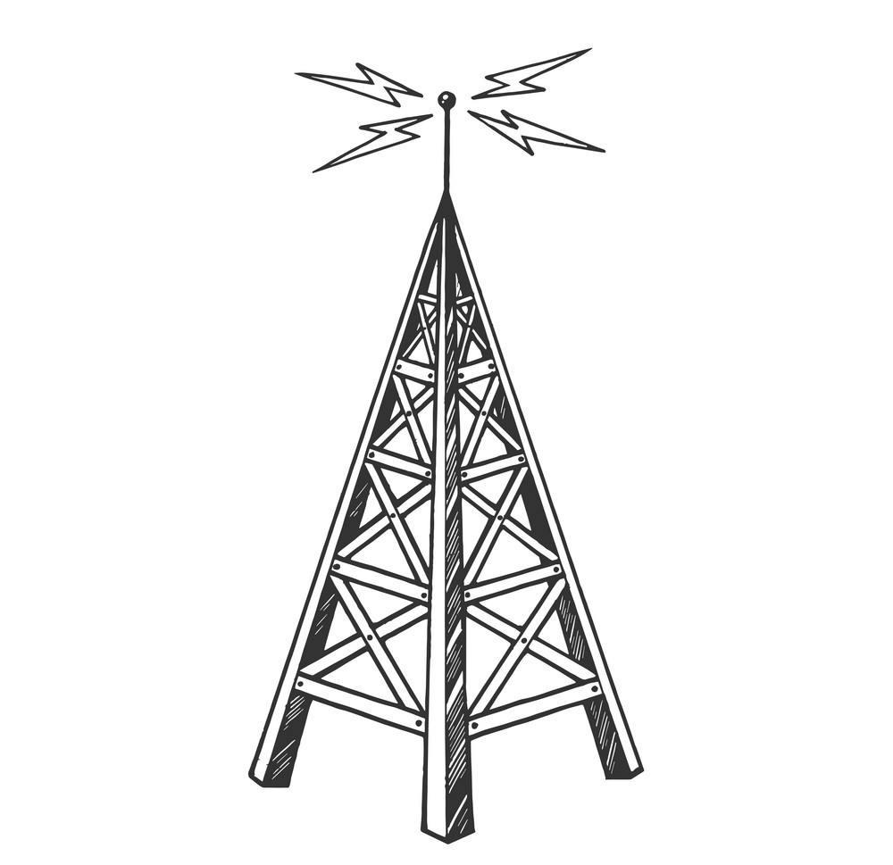
For example, with radio communication, can you send a music signal through the
air, and then recover it and get the “music” out of it and not the noise?
Notes:
Photo: https://www.vectorstock.com/royalty-free-vector/old-radio-tower-sketch-engraving-vector-25220234

Slide 69
Question: What are some other examples of areas where signal processing may be relevant?

Slide 70

Speech Recognition
Notes:
Photo: https://www.infoholicresearch.com/blog/Impact-of-artificial-intelligence-in-speech-recognition-technology/

Slide 71
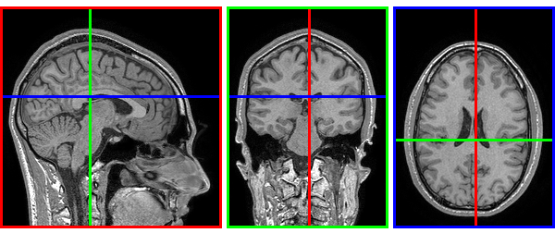
Medical Image Analysis

Slide 72
Frequency Analysis

Slide 73
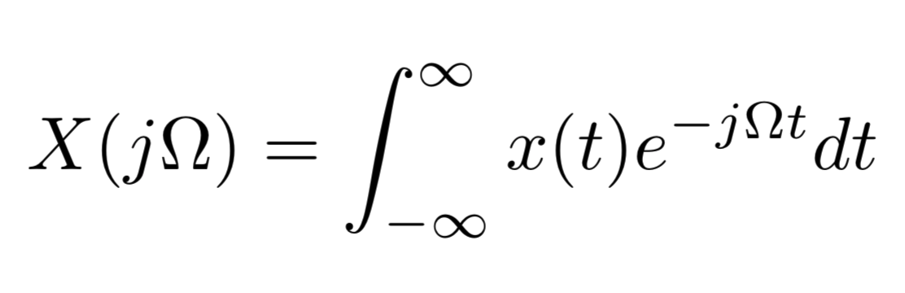
The major concept that we will be focusing on today is a huge topic in signal processing known as frequency analysis.

Slide 74
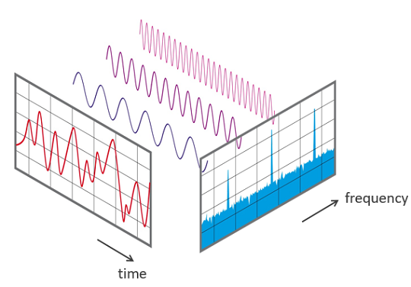
Frequency analysis is a field with which we convert a signal from the time domain into the frequency domain.
Notes:
Photo: https://www.nti-audio.com/en/support/know-how/fast-fourier-transform-fft

Slide 75
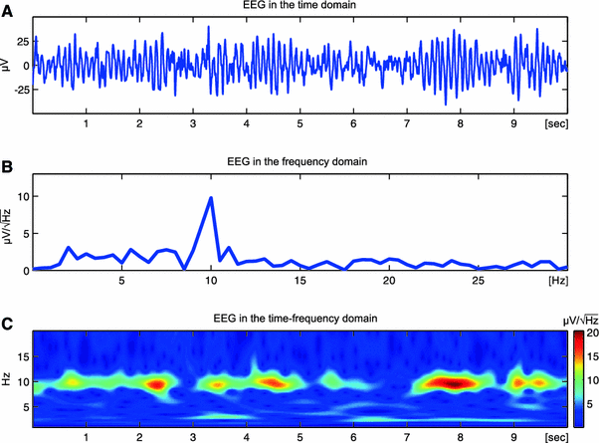
The time domain very abstractly refers to when a signal is represented on a plot where there is some value changing over time.
Notes:
Photo: https://link.springer.com/article/10.1007/s10548-013-0327-5

Slide 76
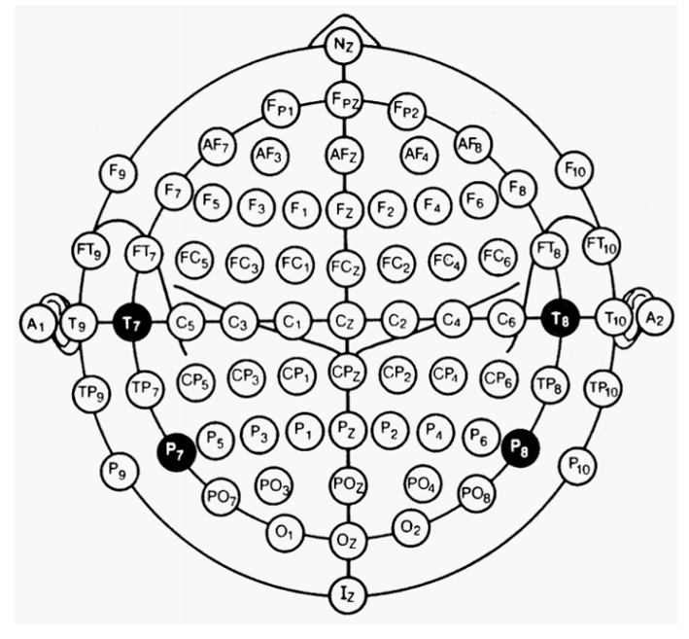
In EEG land, this is voltage over time for some electrode location on the
scalp.
Notes:
Photo: https://link.springer.com/article/10.1007/s10548-013-0327-5

Slide 77
Google Colaboratory:
Plot the time domain representation of one of the EEG signals in the data provided.

Slide 78
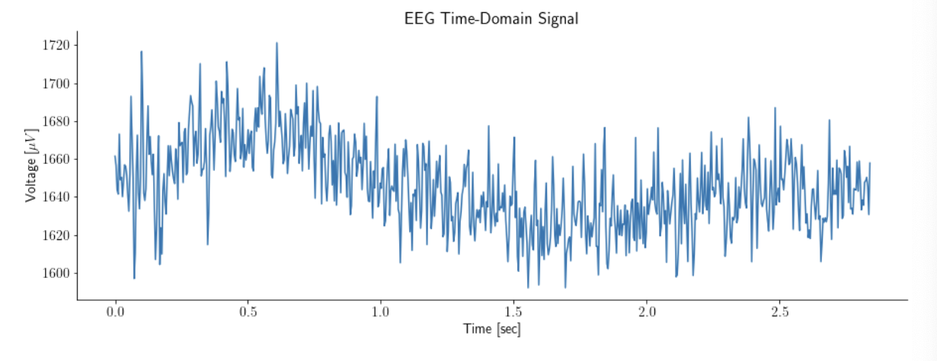
Plot the time domain representation of one of the EEG signals in
the data provided.

Slide 79
Now, let’s start to think about representing the signal shown below here in the frequency domain!
Notes:
Photo: https://link.springer.com/article/10.1007/s10548-013-0327-5

Slide 80
The most often used method for frequency transformation is known as
the Fourier Transform.

Slide 81
With this equation, we turn a time domain signal into a frequency domain signal.
Notes:
Photo: https://link.springer.com/article/10.1007/s10548-013-0327-5

Slide 82
Question: What does frequency refer to?

Slide 83

Something happening some number of times per some unit of time like number of jumps per second (jumps/sec) .
Hertz is usually the unit and this represents number of times something happens per second!
Notes:
Photo: https://yourhealthrights.com/average-jump-rope-per-minute/

Slide 84
Understanding what frequency refers to is good, but how can we turn a signal in the time domain into a signal in the frequency domain, and what does that even mean?
Notes:
Photo: https://www.nti-audio.com/en/support/know-how/fast-fourier-transform-fft

Slide 85
Using the fourier transform, we are basically saying that a random looking signal is made of a composition of sine waves at a certain frequency!
Notes:
Photo: https://www.nti-audio.com/en/support/know-how/fast-fourier-transform-fft

Slide 86
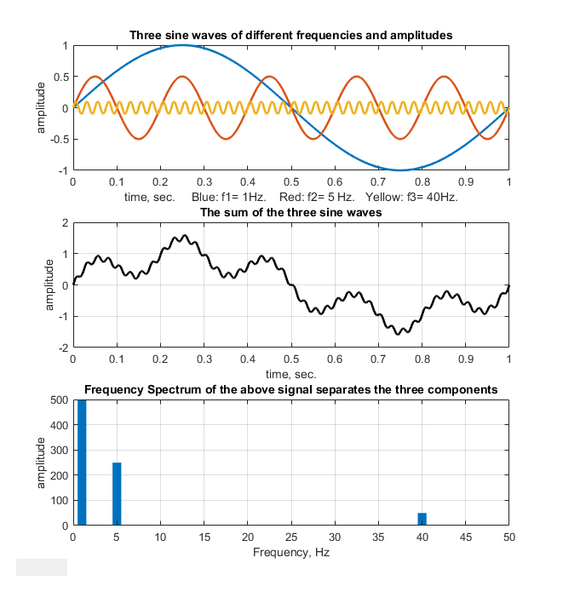
Here is an example where in the first plot, we have three sinusoids, all oscillating at different frequencies.
Notes:
Photo: https://terpconnect.umd.edu/~toh/spectrum/HarmonicAnalysis.html

Slide 87
The signal in the second plot is oscillating at all three frequencies simultaneously!
Notes:
Photo: https://terpconnect.umd.edu/~toh/spectrum/HarmonicAnalysis.html

Slide 88
To represent a signal in the frequency domain, the x-axis is no longer time; it becomes frequency.
Notes:
Photo: https://terpconnect.umd.edu/~toh/spectrum/HarmonicAnalysis.html

Slide 89
In this example, because there are three sine waves with different frequencies, there are three different peaks in the frequency domain.
Notes:
Photo: https://terpconnect.umd.edu/~toh/spectrum/HarmonicAnalysis.html

Slide 90
In this example, because there are three sine waves with different frequencies, there are three different peaks in the frequency domain.
Notes:
Photo: https://terpconnect.umd.edu/~toh/spectrum/HarmonicAnalysis.html

Slide 91
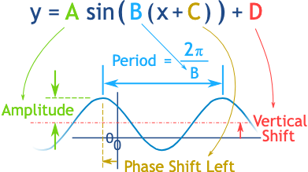
Let’s also review what it means for a sine wave to have a frequency.
Notes:
https://www.mathsisfun.com/algebra/amplitude-period-frequency-phase-shift.html

Slide 92
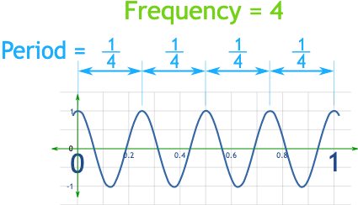
Let’s also review what it means for a sine wave to have a frequency.
Notes:
https://www.mathsisfun.com/algebra/amplitude-period-frequency-phase-shift.html

Slide 93
Question: Why is the value of the three peaks different here?

Slide 94
The amplitude of each of the signals is different, and the frequency domain represents amplitude in some unit on the y-axis.
In our example, the lowest frequency sine wave is the biggest in amplitude. So it’s peak is the biggest.

Slide 95
Google Colaboratory:
Calculate the frequency domain representation of the signal of which you plotted the time domain representation.

Slide 96
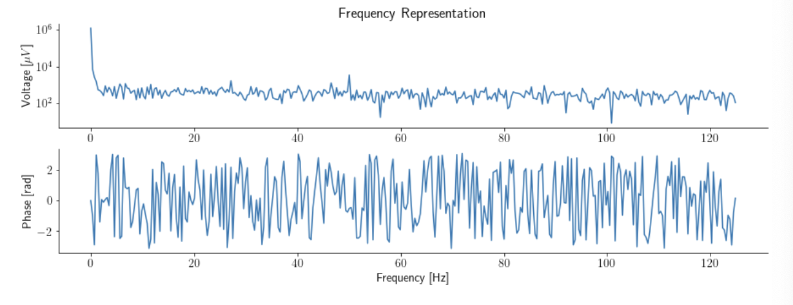
Calculate the frequency domain representation of the signal of which you plotted the time domain representation.

Slide 97
Question: What do you think phase is referring to in our plots?

Slide 98
Phase is referring to, for that frequency, where has the sine wave been shifted.
Each sine wave oscillation (up, down movement) has to start somewhere relative the the start of the signal being analyzed

Slide 99
Filtering

Slide 100
One thing you may have noticed in the frequency domain of our signal is that it isn’t centered around zero.

Slide 101
This isn’t helpful to us understanding the signal, so we want to “fix this.”

Slide 102
In signal processing land, “fixing this” means to extract better information from the signal outside of stuff we don’t want.

Slide 103
So, we will be using a filter to get rid of the fact that the signal is shifted upwards.

Slide 104
Question: The “shifting up” part of the signal doesn’t oscillate much at all. If so, what frequency do you think it represents?

Slide 105
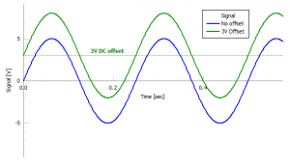
It represents a really low frequency, 0!
It is a component which doesn’t oscillate so it’s a sine wave with a frequency of 0.

Slide 106
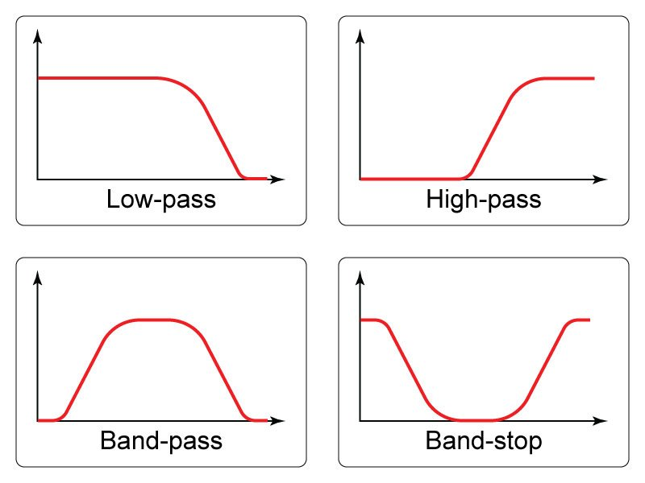
Now, in order to get rid of frequencies that we don’t like, we will use something called a filter.
Notes:
Photo: https://www.allaboutcircuits.com/technical-articles/low-pass-filter-tutorial-basics-passive-RC-filter/

Slide 107
The filters picture down here are in the frequency domain.
Notes:
Photo: https://www.allaboutcircuits.com/technical-articles/low-pass-filter-tutorial-basics-passive-RC-filter/

Slide 108
To use a filter, you basically take the frequency domain of the signal and multiply it by the frequency domain of the filter.
Notes:
Photo: https://www.allaboutcircuits.com/technical-articles/low-pass-filter-tutorial-basics-passive-RC-filter/

Slide 109
So the low pass filter, for instance, will zero all of the higher frequency
components.
Notes:
Photo: https://www.allaboutcircuits.com/technical-articles/low-pass-filter-tutorial-basics-passive-RC-filter/

Slide 110
The high pass filter will zero all of the lower frequency components.
Notes:
Photo: https://www.allaboutcircuits.com/technical-articles/low-pass-filter-tutorial-basics-passive-RC-filter/

Slide 111
Google Colaboratory:
Build a bandpass filter to remove the DC component of the signal (the part that shifts the signal up).

Slide 112
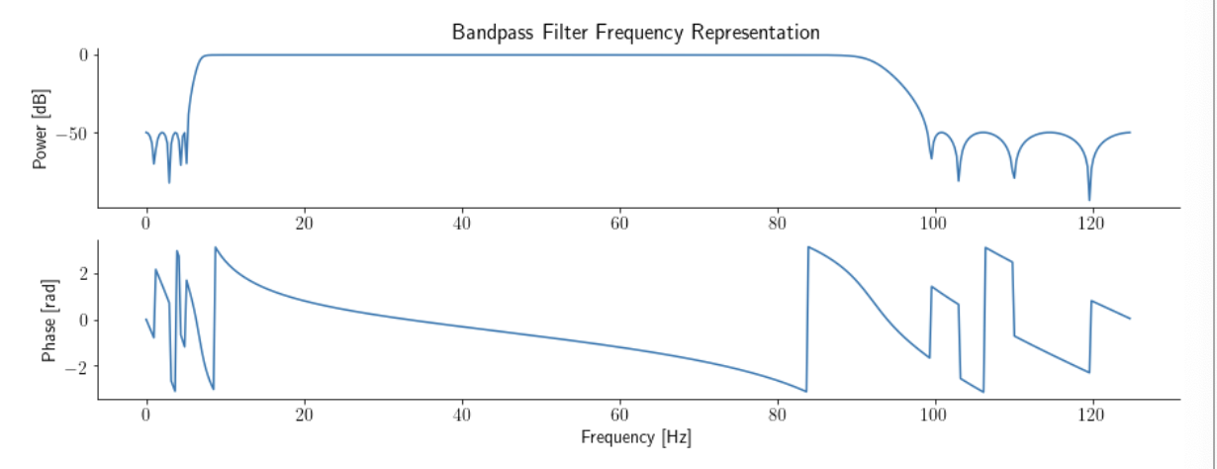
Build a bandpass filter to remove the DC component of the signal (the part that shifts the signal up).

Slide 113
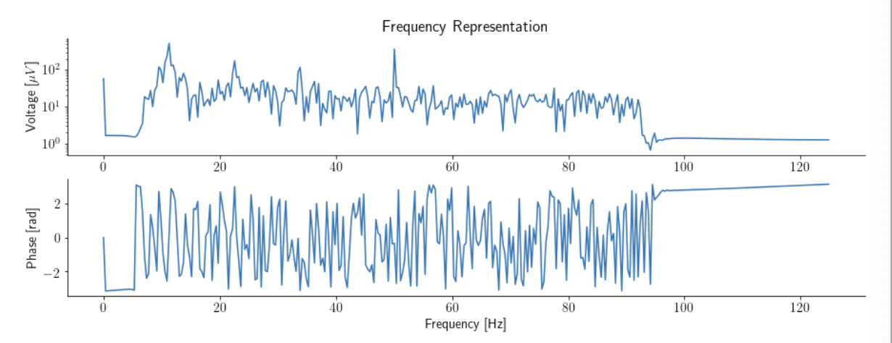
This is the result of multiplying the filter with our original signal.

Slide 114
Question: Given the paper that we have read, why would filters be helpful?

Slide 115
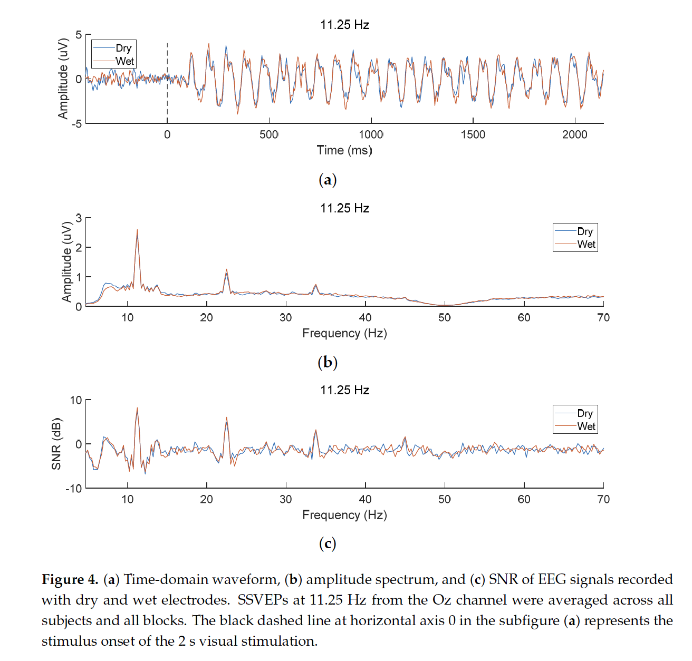
We will want to isolate different frequencies in the signal. SSVEPs are frequencies present in an EEG signal.

Slide 116
Google Colaboratory:
Build a bandpass filter to isolate some frequency band.

Slide 117
Let’s Build Figure 4 From
An Open Dataset for Wearable SSVEP-Based Brain-Computer Interfaces

Slide 118
Google Colaboratory:
Average the Oz Electrode Data and Plot the Time Domain.

Slide 119
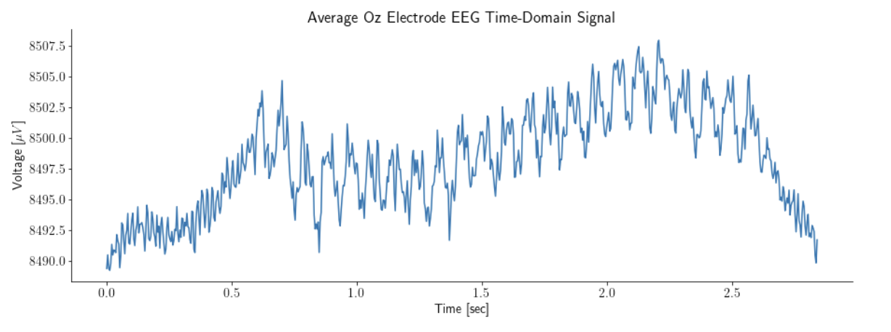
Average the Oz Electrode Data and Plot the Time Domain.

Slide 120
Google Colaboratory:
Bandpass the Signal to Isolate 7.25 Hz to 90 Hz the Plot the Time Domain.

Slide 121
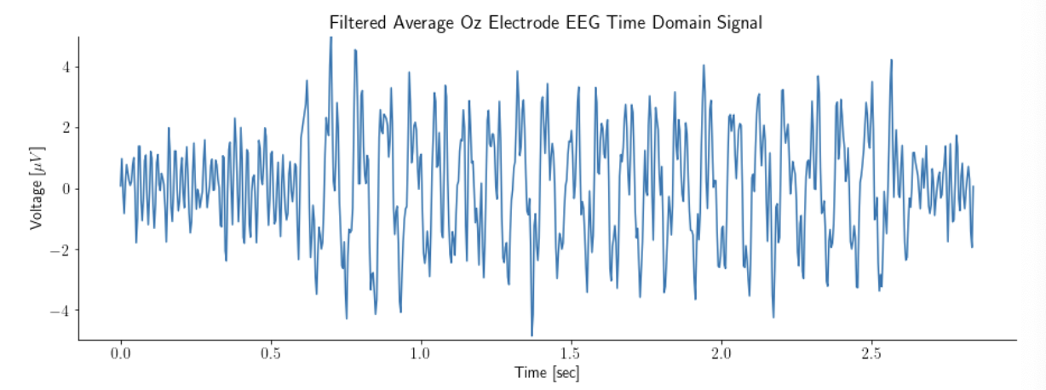
Bandpass the Signal to Isolate 7.25 Hz to 90 Hz the Plot the Time Domain.

Slide 122
Google Colaboratory:
Bandpass the Signal to Extract 11.25 Hz and Plot the Time Domain.

Slide 123
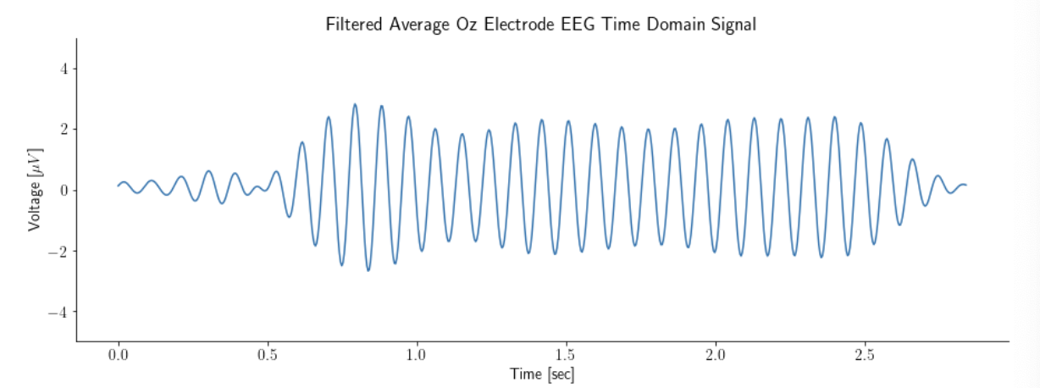
Bandpass the Signal to Extract 11.25 Hz and Plot the Time Domain.

Slide 124
Google Colaboratory:
Bandpass the Signal to Extract a different Band and Plot the Time Domain.

Slide 125
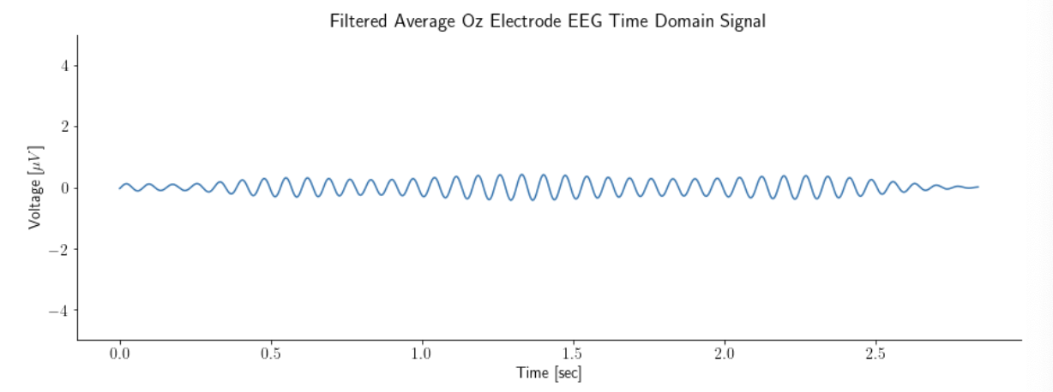
Bandpass the Signal to Extract 11.25 Hz and Plot the Time Domain.

Slide 126
Today, we will be learning about brain signals, and how you can extract information from these signals to make decisions.

Slide 127
Summarize:
Write down the main takeaways you got from today’s lesson.

Slide 128
Taylor Baum
tbaum@mit.edu
taylor.e.baum@gmail.com
https://www.linkedin.com/in/taylor-baum-b1a4aa105/

Slide 129
Neuroscience
Signal Processing
Quantitative Methods Workshop 2022
Taylor Baum

Slide 130
Content Resources Used
Buzsáki, György; Anastassiou, Costas A.; Koch, Christof (2012). The origin of extracellular fields and currents — EEG, ECoG, LFP and spikes. Nature Reviews Neuroscience, 13(6), 407–420. doi:10.1038/nrn3241
https://www.mayoclinic.org/tests-procedures/eeg/about/pac-20393875
https://battlebornbatteries.com/amps-volts-watts/
Britton JW, Frey LC, Hopp JLet al., authors; St. Louis EK, Frey LC, editors. Electroencephalography (EEG): An Introductory Text and Atlas of Normal and Abnormal Findings in Adults, Children, and Infants [Internet]. Chicago: American Epilepsy Society; 2016. Available from: https://www.ncbi.nlm.nih.gov/books/NBK390354/

